Slide 1
WebbShade DURABLE. BUILT TOUGH. GUARANTEED
“Zero Maintenance. We don’t have to take them down to clean them. We vacuum them right in place. Nothing breaks. WEBB is so much better than our verticals, which were always broken.”
Jeff Siebels Environmental Services Director Perham Memorial Hospital & Home, Perham, Minnesota

Slide 2
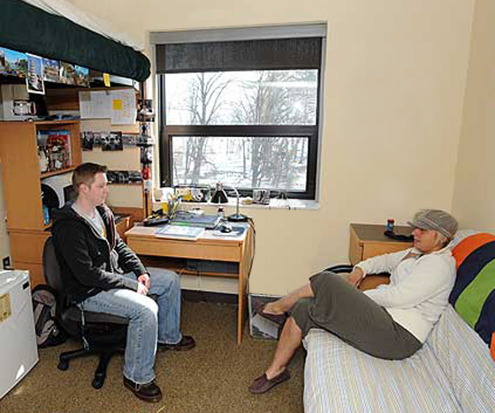
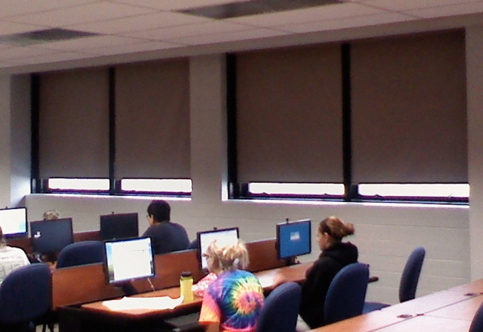
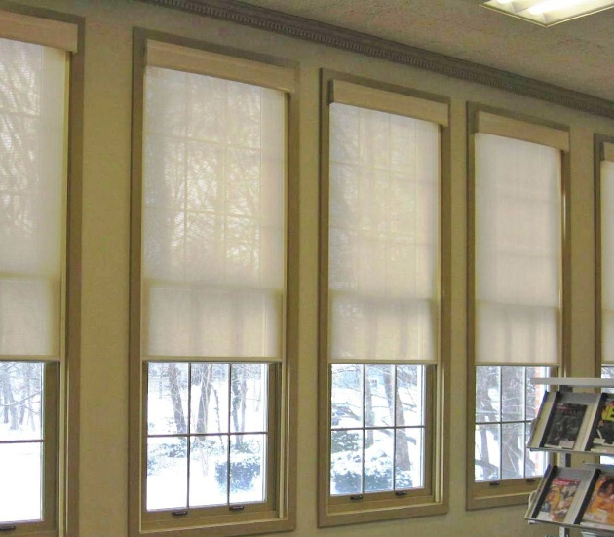
WebbGlide Cordless, Easy to Use, Maintenance-Free Window Shade

Slide 3
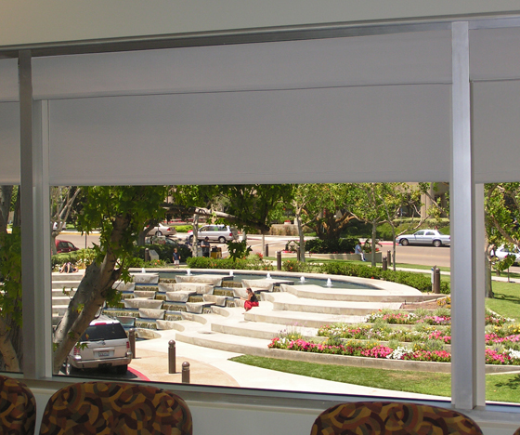
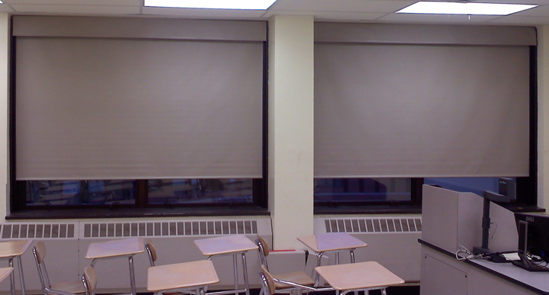
WebbGlide Fabric Valance

Slide 4
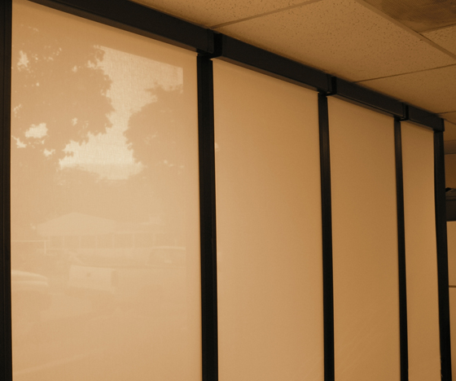
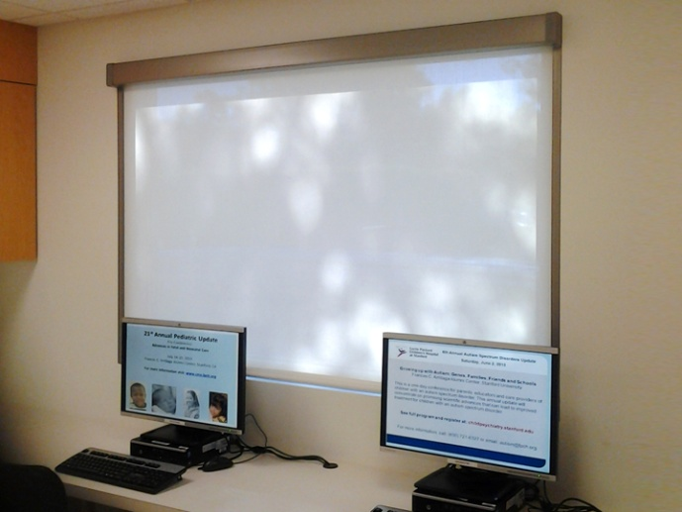
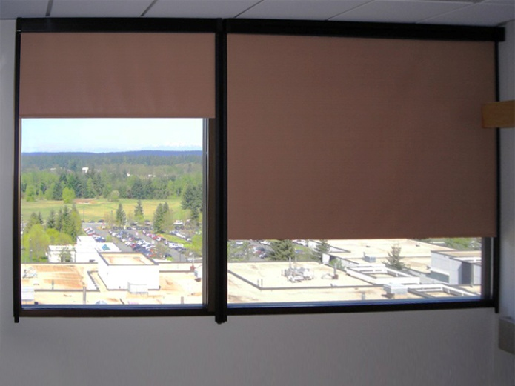
WebbGlide ABS Valance

Slide 5
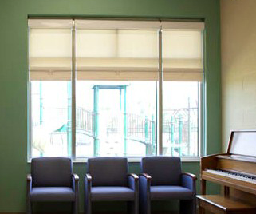
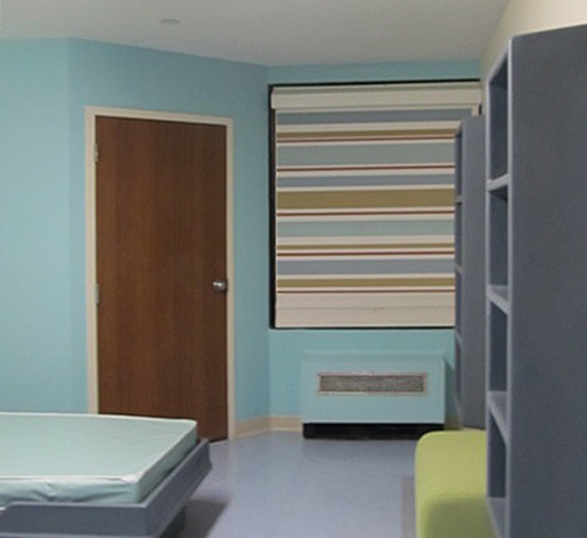
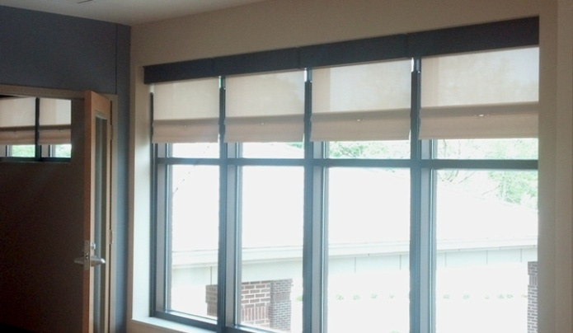
WebbLok Proven Behavioral Health Solution for Over 35 Years

Slide 6
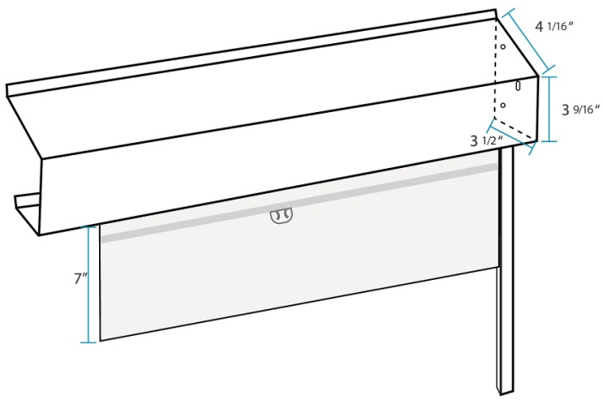
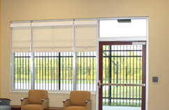
WebbLok Exclusive Security Box and Back Plate

Slide 7
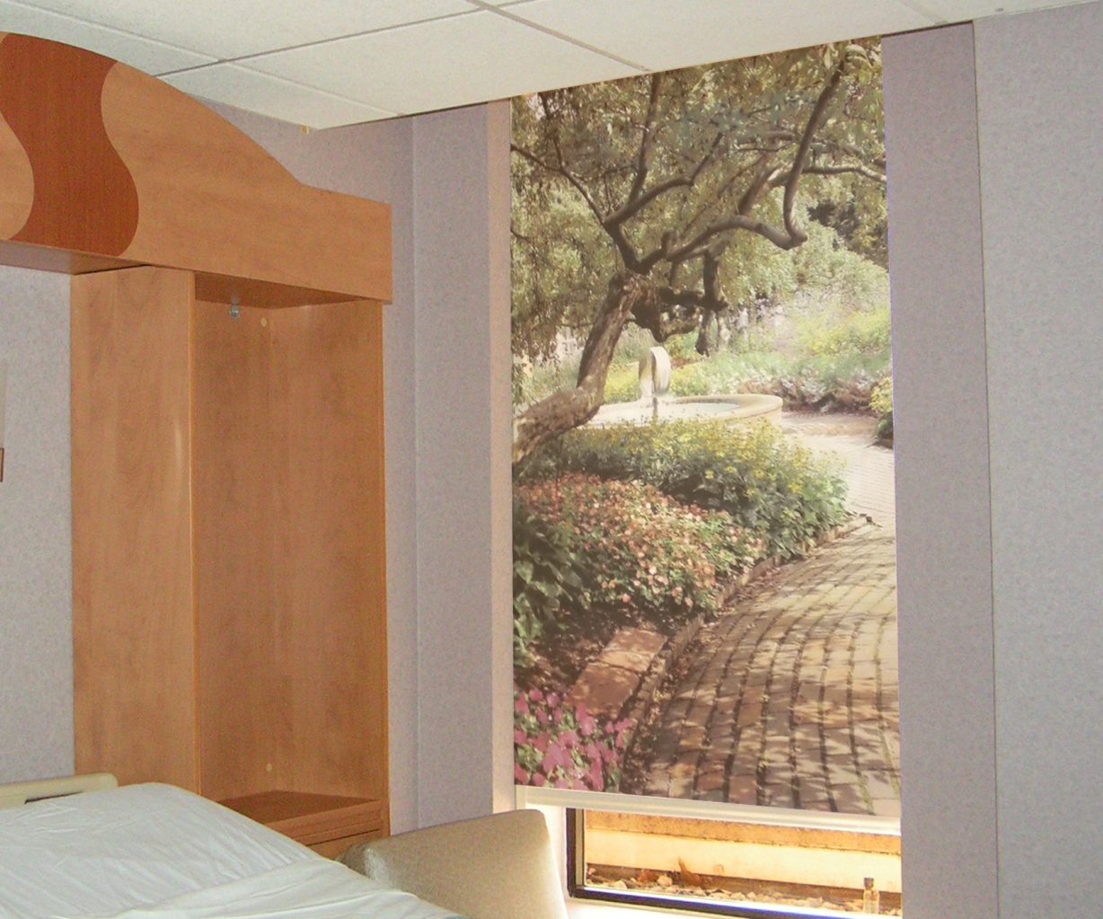
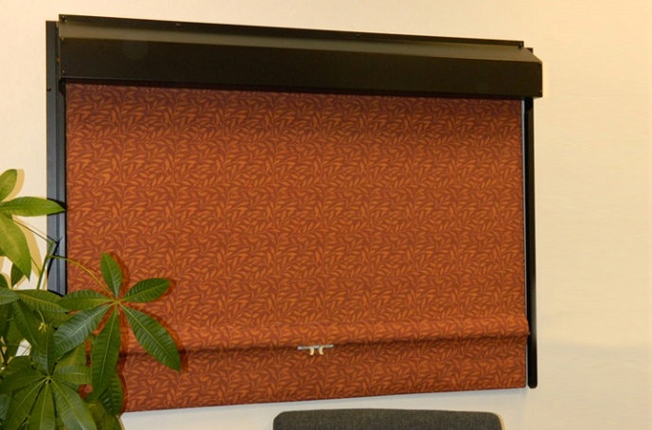
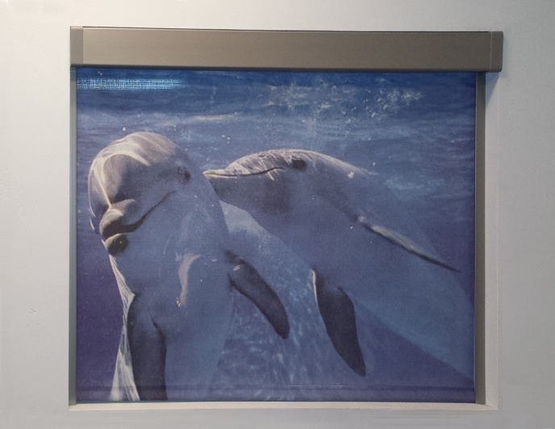
Hybrid Shade Doubles as Art Work
Custom Printed Fabric Shade

Slide 8
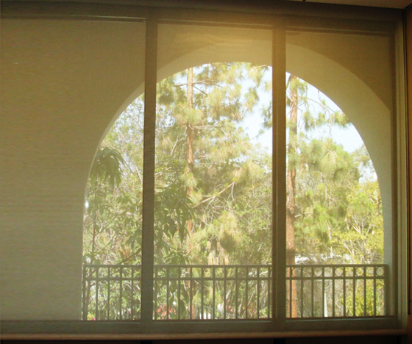
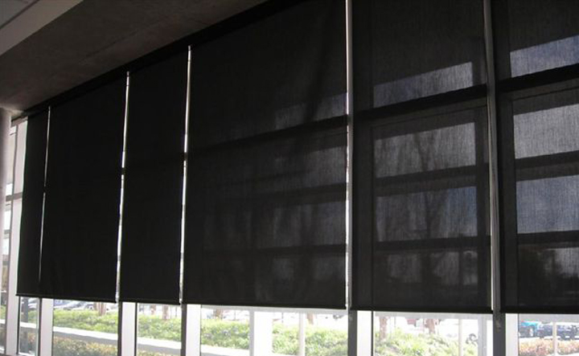
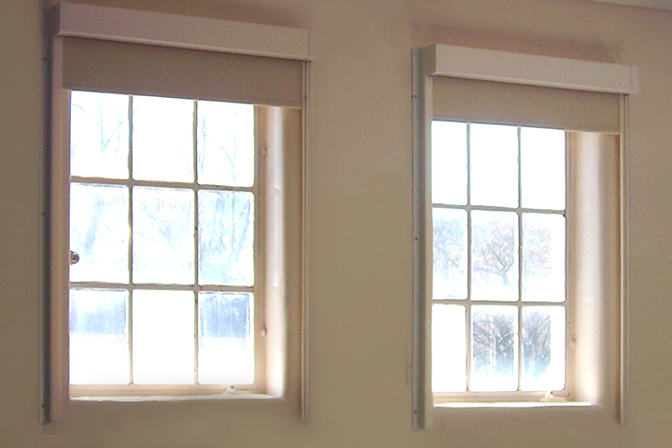
WebbClutch Heavy Duty, Manual Operated Solution for Hard to Reach Windows

Slide 9
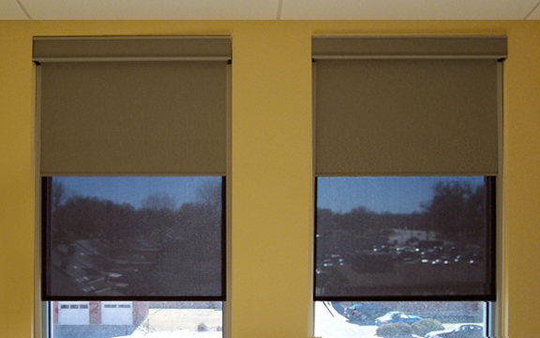
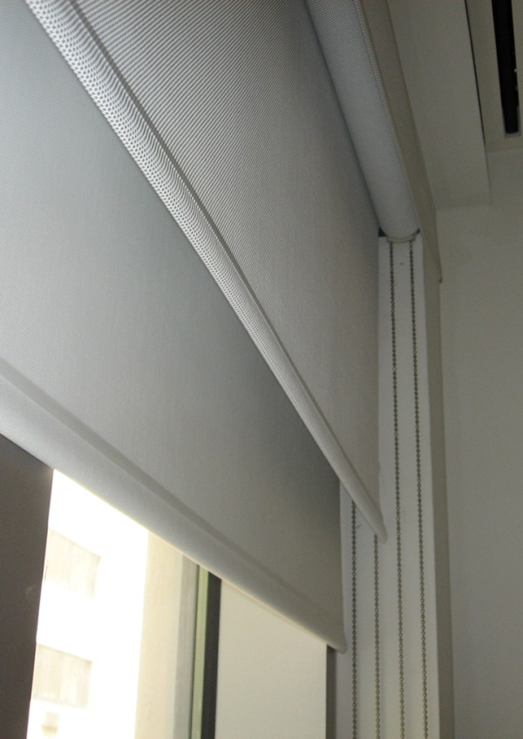
Dual Shades Optimize Light Control for Every Situation

Slide 10
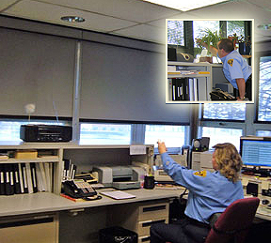
Motorized THE Solution for Out of Reach Windows

Slide 11
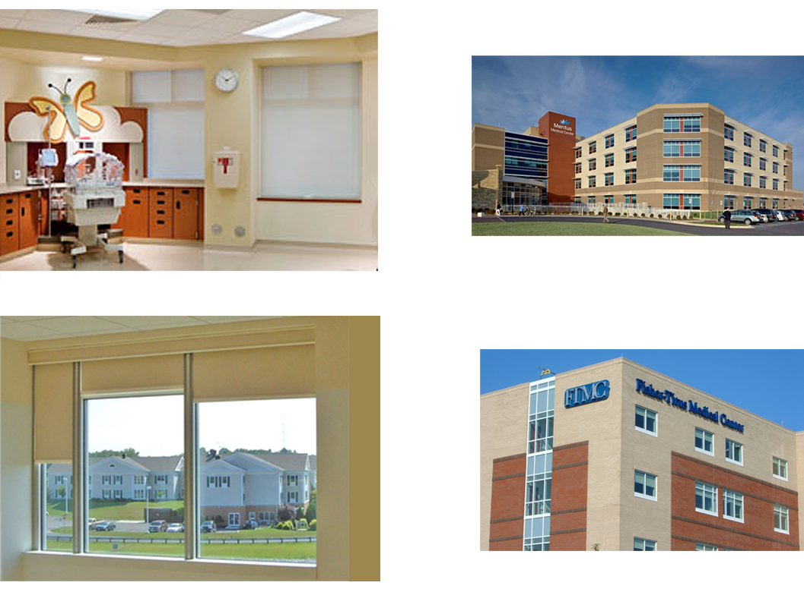
WebbShade DURABLE. BUILT TOUGH. GUARANTEED

